Slide 1

Particle Trapping in M Dwarf Disks
Kevin White
Steven Desch, Anusha Kalyaan
2018 Arizona Space Grant Symposium
4/14/18

Slide 2
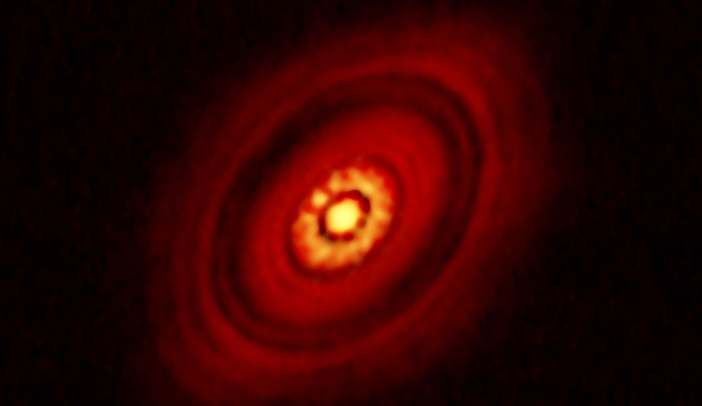
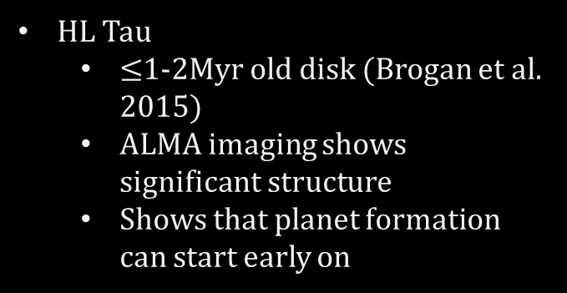
Observation of Gaps in Disks
HL Tau
  $≤$1-2Myr old disk (Brogan et al. 2015)
  ALMA imaging shows significant structure
  Shows that planet formation can start early on
(credit ALMA/ESO/NAOJ/NRAO)
Isotope Reservoirs
  Likely that Jupiter formed very early in solar disk (<1Myr)(Kruijer et al. 2017)
    Reservoirs of non-carbonaceous and carbonaceous meteorites
    Early and rapid growth would have created a large gap in the disk

Slide 3
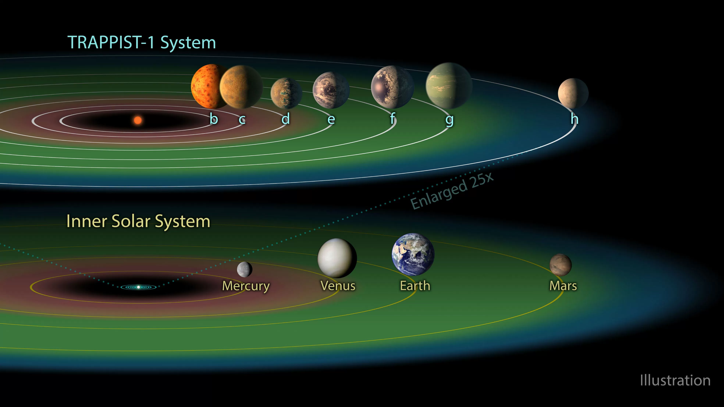
Volatile Content of Terrestrial Planets
Volatile content influenced by where a planet forms
Snowlines form boundary beyond which water is ice
Inner solar system is water-poor, outer is water-rich
  Earth is ≤0.1wt% water (Mottl et al. 2007)
Planets around TRAPPIST-1 have resonant orbits (Gillon et al. 2016, 2017)
  Implies they migrated inwards to their present orbits
TRAPPIST-b and -c are likely ~7wt% water, while planets d-h are >50wt% (Unterborn et al. 2018, in review)
Implies –b and –c formed interior to snowline
Still higher wt% water than Earth, suggesting volatile gradient is less sharp in M Dwarf disks
(credit Cal-Tech JPL/NASA)

Slide 4
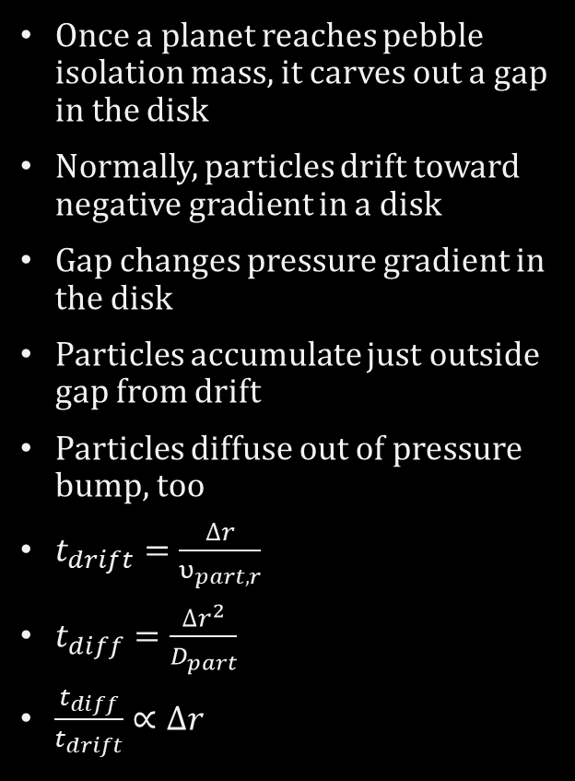

Particle Trapping
Once a planet reaches pebble isolation mass, it carves out a gap in the disk
Normally, particles drift toward negative gradient in a disk
Gap changes pressure gradient in the disk
Particles accumulate just outside gap from drift
Particles diffuse out of pressure bump, too
$t_{drift}=\frac{∆r}{υ_{part,r}}$
$t_{diff}=\frac{∆r^{2}}{D_{part}}$
$\frac{t_{diff}}{t_{drift}}∝∆r$
$$r_{H}$$
Σ
r

Slide 5
Disk Evolution Code
1D disk evolution code in Fortran
  Includes particle transport (Desch et al. 2017,2018 in review)
  Passive temperature profile
Gap
  Opens when planet reaches pebble isolation mass (Lambrechts et al. 2014, Ormel et al. 2017)
    G Dwarf: 30 Earth masses at 3 AU
    M Dwarf: 1 Earth Mass at 0.3 AU
  Planet does not migrate
Ran disk evolution for two million years to see how particles diffuse and drift across gap and compared timescales

Slide 6
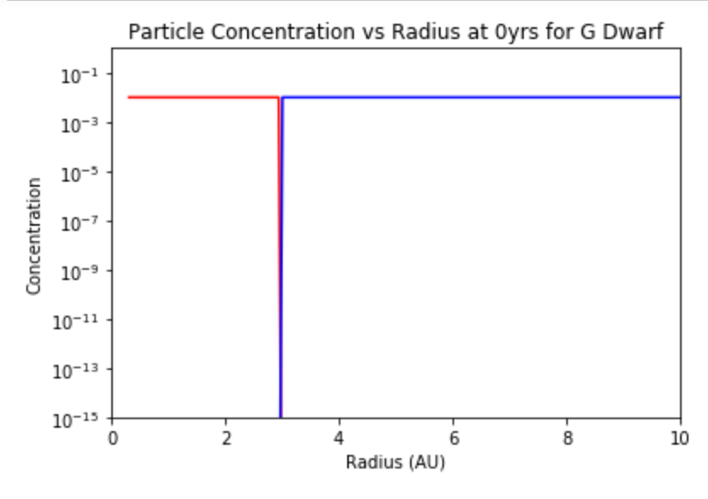
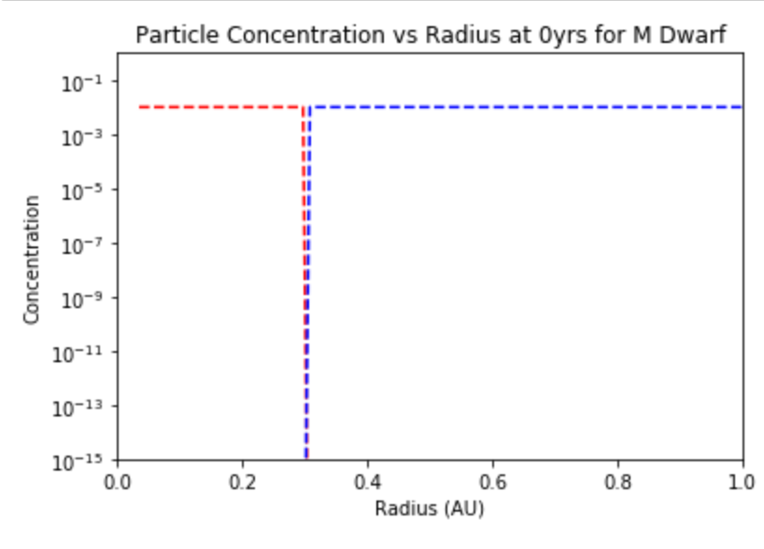
Results
At t=0Myr
(0.5cm radius, “red” particles are interior to gap, “blue” are exterior)
G Dwarf disk
M Dwarf disk
Concentration
Concentration

Slide 7
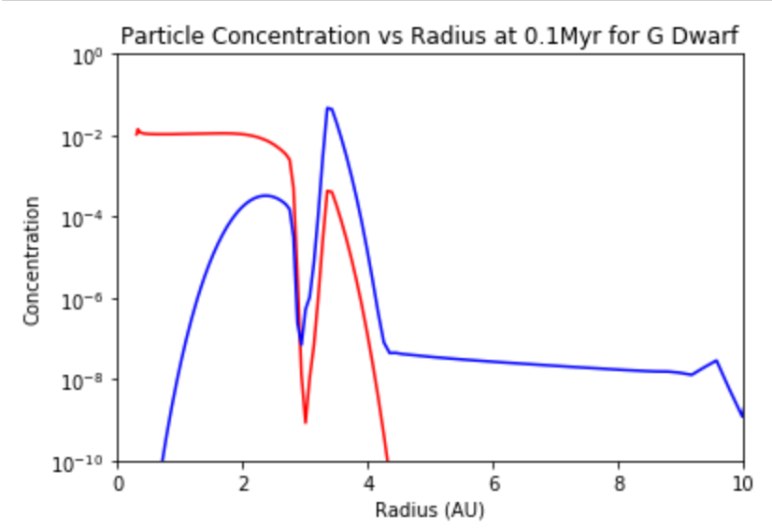
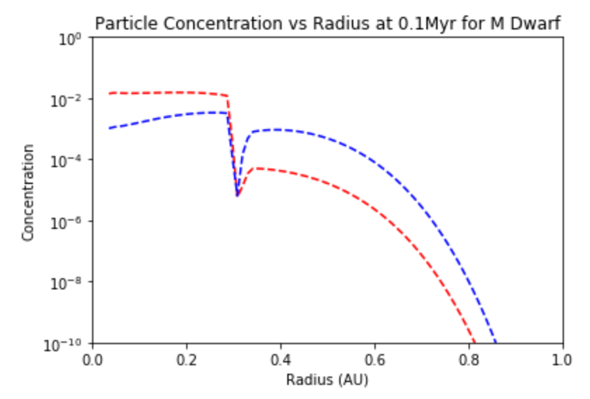


Results
At t=0.1Myr
G Dwarf disk
M Dwarf disk
Concentration
Concentration
$$\frac{t_{diff}}{t_{drift}}=1.364$$
$$\frac{t_{diff}}{t_{drift}}=0.118$$

Slide 8
Conclusions
We wanted to test efficiency of particle trapping in G Dwarf and M Dwarf disks
We found that G Dwarf disks are more effective at trapping particles than M Dwarf disks
Particles in M Dwarf disks likely diffuse better

Slide 9
Acknowledgements
Dr. Steven Desch, Space Grant mentor
Anusha Kalyaan, SESE graduate student
Desiree Crawl, senior coordinator

Slide 10
Thank you

